Slide 1
Scripting

Slide 2
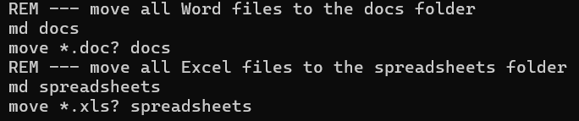
Scripting vs Programming
There is a difference, but it’s not always completely clear…
Scripting originally meant creating a file with a short list of CLI (command line interface) instructions. Running a script file reduced how much typing was required and enabled some processes to be automated.
This is a simple example of a script file:

Slide 3
Scripting vs Programming
All programs require an Operating System to run
Script files may require additional software or applications
  HTML is the script file for a webpage, which requires a web browser
  Py files for Python require the Python software to be installed
Modern scripting languages are often interpreted by the additional software:
  Scripted instructions are converted at runtime to operations the CPU understands.
  These CPU operations are then executed as needed

Slide 4
Scripting vs Programming
Programming generally refers to creating software that runs on a computer without the need for additional software at runtime*
Programs are compiled into directly executable CPU instructions during development
Programming languages are historically more closely related to computer / CPU architecture, which makes the compilation process simpler and faster
But as we will see, scripting and programming are not so different in many cases!

Slide 5
Scripting is almost the same as Programming
Some newer languages like Java and C# combine elements of programming and scripting
  Source code is compiled into an intermediate format
    This format is independent of hardware or operating system
    It is referred to as 'ByteCode'
  ByteCode can be moved as needed and run on other computers
    ByteCode is loaded by 'Virtual Machine' (VM) software specific to the hardware/OS
    The VM performs a final just-in-time compile step to convert code to native format
    Code is executed though the VM
  C# uses the .NET runtime
  Java uses the Java Virtual Machine (JVM)

Slide 6
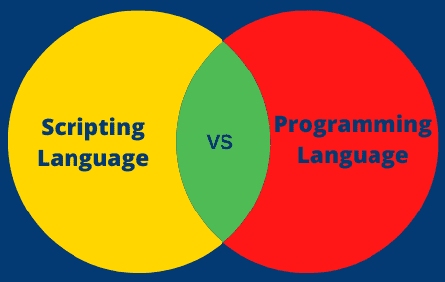
Scripting vs Programming
Programming refers to creating software that runs on a computer without the need for additional software at runtime
C#
Java
Basic
JavaScript
Python
Lua
PHP
C / C++
Rust
Go
COBOL
Assembler
https://www.scientecheasy.com/2022/01/scripting-language-vs-programming-language.html/

Slide 7
CLI Scripting

Slide 8
CLI Scripting is powerful
Scripting is generally simpler than programming
  Easier to develop for simpler tasks, but there are usually limits
  Tools are simpler and easier to learn (just a text editor!)
Most programming concepts can be implemented in scripts!
Operations / operators
Functions
Variables
Switches/options
Conditions
Loops
Outputs
Input files
Data types

Slide 9
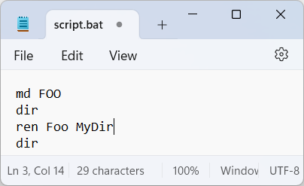
Scripting Commands
Commands can be combined into a batch script to run in sequence
We can create CLI Script 'batch files' to store multiple commands to be executed in sequence
  .bat – extension files contain a sequence of commands.
  The ‘.cmd’ extension is also used.

Slide 10
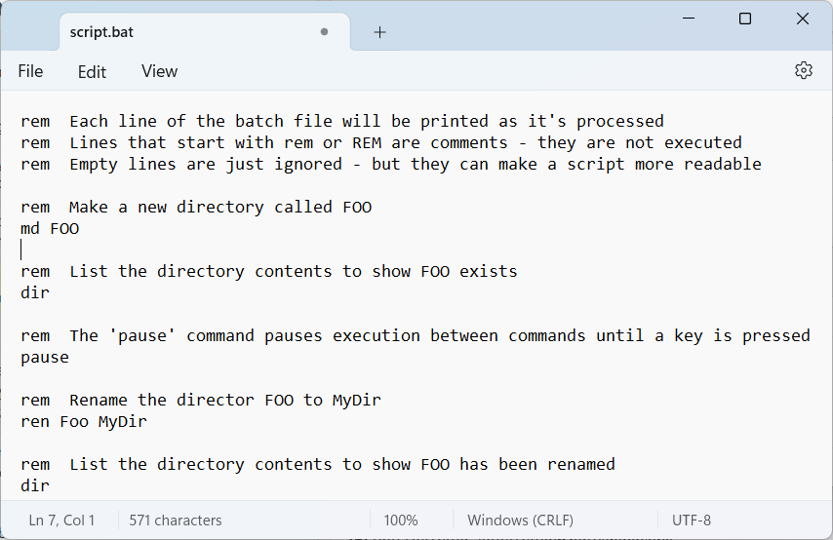
Scripting Commands
Batch files can be very powerful as we will see.
Notepad is a simple editor – but it works well for text files.

Slide 11
Sequence: Variables
You already have the basics of this … a list of commands or programs will run in sequence in a batch file
Batch files can also use variables. Use the keyword 'set' to assign a value to a variable
  set username=Roland
Note that quotation marks are not necessary
Also be aware that the assigned value starts immediately after the equals sign. So set username= Roland will put a space in!

Slide 12
Sequence: Variables
Once set variable can then be used: put % before and after the variable name to get its value:
  echo %username% will print the value
'set' can assign a new value to a variable:
  set username=Hector224
Or 'set=' to delete the variable
  set username=Hector224
Use 'set /?' to see full help on this command. It has many more features that can be useful

Slide 13
Sequence: Array Variables
Array variables are similar to Lists in Python, but not formally defined as part of the language - but you can implement them
Use 'set' to assign a multiple values to a single variable
  set names=Hector, Paul, Mia, Ana
* note that the commas are optional
Or 'set' can assign individual positions in the array
set names[0]=Hector
set names[1]=Paul

Slide 14
User Input
We can also use the set command to assign user input to a variable
'set /p' allows you to set the value of a variable to input text entered by the user
It's used in the form 'set /p variable_name=prompt_text'
For example:
set /p username=What is your username?

Slide 15
Output: Echo
The echo command simply prints commands or text messages to the screen.
By default, every statement in a script is "echoed" to the screen when it is executed
Turn echoing off with the command:
  @echo off
Using the @ symbol before a command suppresses that command's echo. It is common to see @echo off at the top of a script file.
Display a message to the user with echo as well
  echo Processing data files …

Slide 16
Output: Echo
The echo command is also used to display the value of variables
set /p username=What is your username?
echo %username%
These lines will display the prompt "What is your username?", and then store the response into the variable username.
Remember the % around the variable name is necessary to specify that you want the value of the variable.

Slide 17
Sequence, Selection and Iteration
Most of what we've looked at so far, is how scripts execute commands and run programs in sequence
But when run from a script/batch file, we also have access to the other key concepts: Selection and Iteration
Although the OS shell may not offer all the functionality of programming language, most allow for very complicated scripts that perform a wide range of tasks

Slide 18
Selection: if and if-else
If statements allow you to compare values and variables, and choose different operations based on the results
The if statement works like you would expect:
  In this example, variable str1 stores a value entered by the user. It is compared to the value 'admin', and if true display the message.
If statements can be nested to enable checking for multiple conditions.
set /p str1=Enter your username
if %str1%==admin echo You are admin

Slide 19
Selection: if and if-else
If-else statements are similar but have unusual syntax:
With an if-else statement, commands to be executed are placed within parentheses: ( )
If the parentheses are not used, commands may be executed incorrectly
set /p str1=Enter your username
if %str1%==admin (echo You are admin) else (echo ??)

Slide 20
Iteration
Iteration is the final concept we'll explore
Batch files have only one looping construct – the for loop
The basic syntax is fairly simple. If we have an array of names and we want to display them all:
  set Names=Hector, Paul, Mia, Ana
  for %%n in (%Names%) do echo %%n
Assign some values to the variable Names
for keyword starts the loop
%%n is the index variable.
%% is needed in batch files, and the variable must be a single letter.
%Names% has the value list to loop through
'do' the command echo where n has a value from Names

Slide 21
Iteration
Loops are often used to process multiple files and/or folders
The syntax is remains similar, but instead specifying an array variable to loop through, you specify the pattern to match – typically using wildcards:
  Loop through all files for %%f in (*) do echo %%f
  Loop through Excel files for %%f in (*.xlsx) do echo %%f
Loop through all folders for /d %%f in (*) do echo %%f

Slide 22
Iteration Notes
for loops can be use very flexibly – but the syntax can be complicated to enable this flexibility and can lead to errors when writing script files
for loops use a different variable syntax: % followed by a single letter, e.g. %x , when typed at the Command Line.
When used in a batch file, a second percent symbol is needed, e.g. %%x.
Check out the help and references to better understand what for can do

Slide 23
Scripting Automation
Batch files can execute a combination of programs and commands
This allows for automation of repetitive tasks and processes, and minimising the chance of human error – once the script is thoroughly test
This concept is behind many of the tasks that software developers perform every day:
  Testing
  Program build and deployment
  Removing empty files and folders
  Comparing files and folders
  Sending emails
  Scheduled file backups

Slide 24
Resources
Windows commands | Microsoft Learn
An A-Z Index of Windows CMD commands - SS64.com
Windows Batch Scripting - Wikibooks, open books for an open world

Slide 25
Using Batch Files

Slide 26
CLI Scripting is powerful
Why write a complicated program when you don't need to?
Shell scripting is similar to "real" programming but generally takes less effort and provides more practical value.
Script files often solve annoying small problems, replacing human time and effort with smooth automation
We're sticking to the Windows/DOS shell for this module as a simpler starting point. Linux/Unix and Bash are more powerful and a good next step.

Slide 27
Scripting example 1
When Company A brings on a new employee:
  Create employee accounts on all internal systems
    Email
    Cloud storage
    Internal messaging/chat
  Send employee 'Welcome email'
  Send employee 'Register for Payroll System email'
  Send 'New team member email' to employee's new teammates
  Add employee to appropriate team email group
  Send employee Company Handbook and links to online resources
  etc.

Slide 28
Scripting example 2
When an employee leaves Company A:
  Freeze access to employee accounts on all internal systems
  Automatically reply to any incoming email
  Remove employee from email groups
  Switch employee active email address to personal account
  Send employee 'Departure email' from HR
  Send employee 'Final Paycheck process email'
  Send employee 'P60 process email'
  Send link to 'Exit Survey'
  etc.

Slide 29
What if someone forgets to do something…?
When a new employee starts or when an employee leaves…

Slide 30
File Processing
A simple example: an old fashioned Payroll program
Every week each employee’s pay is calculated
  Employees submit a timesheet with their hours worked during the week
  The timesheet is a file named after the employee ID: "time_?????.txt"
  Weekly timesheet files are all put in a directory named after the last working day of that week, e.g. "Fri_20_Dec_2024"
  To process pay data on time, the company needs two things by 9am Monday morning:
    For every 'time' file, a corresponding 'pay' file called "pay_?????.txt" with the pay and tax information for the employee.
    A single file called "pay_totals.txt" that contains the total amount to be paid to employees and their taxes.

Slide 31
Batch Files & Executable Files
  Batch files are very good for automating repetitive tasks
  For example, running a script to process all files in a directory
  A few more features of batch files make the combination of batch files and executable files more powerful:
    Batch file parameters
    'Calling' other programs from within batch files
    Executing script commands out of sequence

Slide 32
Script Parameters
In addition to variables that are set within the script, batch files can accept additional information passed in as parameters
Command line arguments are listed after the file name on the command line:
  MyScript.bat 5 Hello
When MyScript.bat is executed, the parameters 5 and Hello can be used through the variables %1 and %2
Up to 9 parameters can be easily passed to batch files:
  echo %1 will print the first parameter's value

Slide 33
Calling Other Scripts
Good organisation of code/script is essential – especially as programs get bigger and more complicated
Batch files can use the call command to invoke other batch files
We have a script that makes a copy of the file passed to it:
make_backups.bat will call backup_file.bat for each file in the current directory
REM - backup_file.bat
copy %1 %~n1.backup
What do you think this does?
REM - make_backups.bat
for %%f in (*) do (call backup_file.bat %%f)

Slide 34
Calling Other Scripts
Lines of commands can be grouped into informal functions, which can then be called from elsewhere in the script
The top section acts as the 'main' part of the script.
The for loop will find all files, passing the names as parameter to func
When exit is reached, the script will exit
func is simple function that prints the value passed in.
REM files.bat
@echo off
for %%f in (*) do (call :func %%f)
exit /b
REM ---- end of main section ----
:func
echo File %~1 found!
exit /B 0
REM – exit ends the function
Note that the goto command can also be used to jump between blocks of commands.

Slide 35
Command Experimentation
This has been an introduction to the Command Shell – but there is much more to it.
Experiment with commands to understand how they work!
Use help to see what is available to you
  Type help to get a list of all commands
  Type help <command> for details on a specific command:
    help dir
Please use caution - some commands require administrator rights.
  And some may be unsafe to run unless you know what you’re doing.
  Be very careful with any commands that delete files.

Slide 36
CLI References
Windows
  Batch Script - Commands (tutorialspoint.com)
  Writing a Windows batch script – GeeksforGeeks
  Windows commands | Microsoft Learn
BASH
  Bash Commands: The Ultimate Cheat Sheet + Downloadable PDF (phoenixnap.com)
  Shell Scripting for Beginners – How to Write Bash Scripts in Linux (freecodecamp.org)
  Bash Shell Scripting Advanced Tutorial

